Slide 1


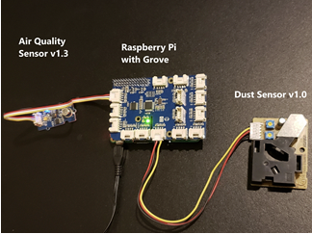
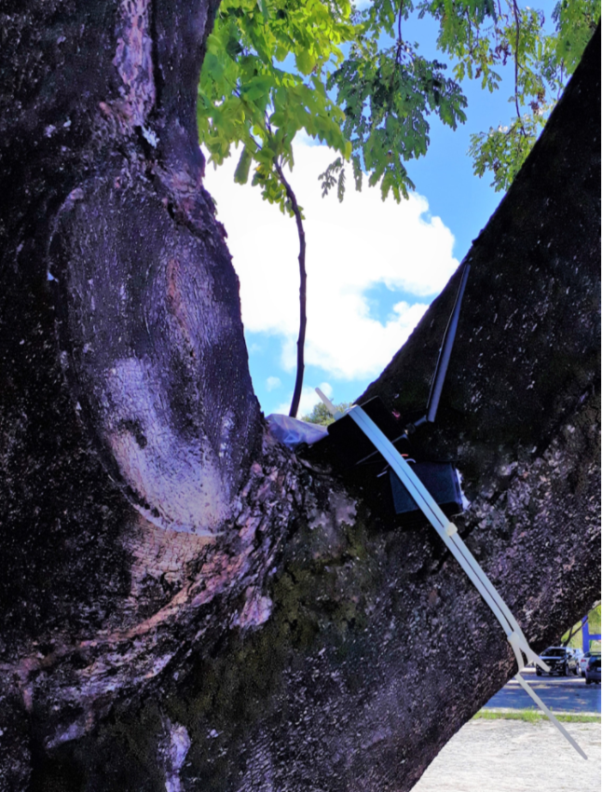
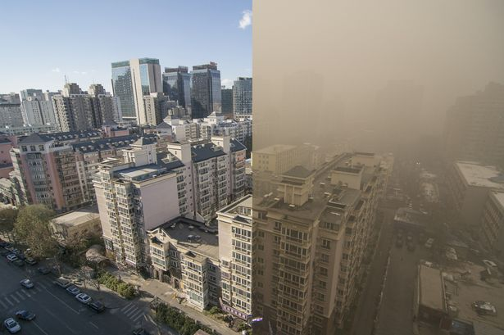

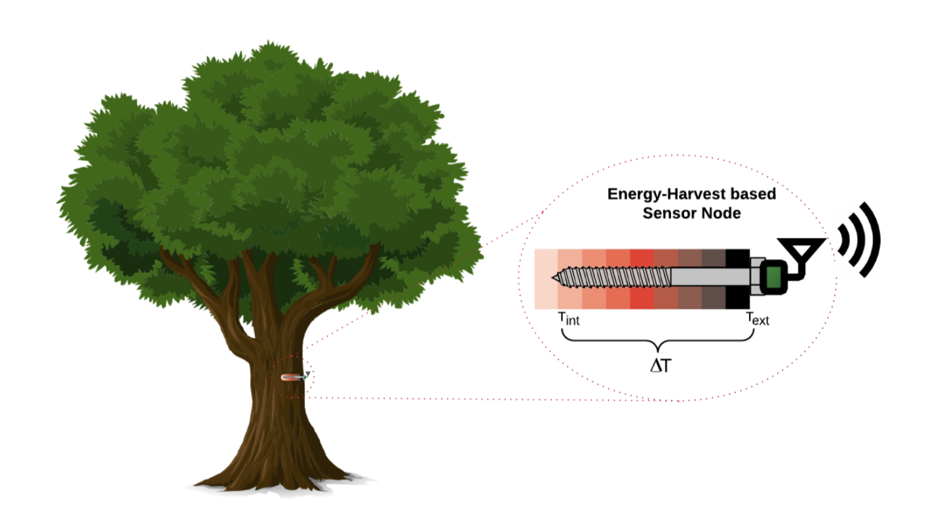
THERMOELECTRIC GENERATORS EMBEDDED IN TREES TO POWER WIRELESS SENSOR NETWORK: TRACKING AIR QUALITY SUSTAINABLY
Eyhab Al-Masri¹, Francisco Baiocchi¹, Orlando Baiocchi¹, Katalina Biondi¹, Graham Boyer¹, Eric Carlson¹, Jared Ferguson¹, Suganya Jeyaraman¹, James Olmsted¹, Eric Pospisil¹, Nicholas Purcell¹, Cleonilson Protasio de Souza², James Stevens¹, Selina Teng¹
THIS PROJECT EXPLORES THE USE OF THERMOELECTRIC GENERATORS (TEGS) POWERING A NETWORK OF IoT SENSORS TO DETECT AIR POLLUTION IN REALTIME. TEGs embedded in trees fuel a low-powered network of air pollution sensors, harvesting energy from the temperature gradient between the interior and exterior of the tree trunk. This source of renewable energy offers a sustainable way to monitor air quality in long-term setups and in remote forested areas, requiring little maintenance and upkeep.
LEVERAGING AZURE IOT HUB
CHART TITLE
Microsoft Azure framework is used to control a system of Raspberry Pi devices from one centralized environment. Fig. 2 presents the application layer for our air pollution detection system. Through this layer, data is collected from multiple edge devices to Microsoft Azure.
IoT is well suited to air quality monitoring systems because it allows sensors to continuously upload and process data without human oversight [7]. This interconnected model enables home and city infrastructures to sense and process information in the background, creating a “smart environment.” Here, IoT enables us to create Smart Trees that can generate their own energy by TEGs to communicate with the network. Cloud computing offers on-demand access to data around the globe with a pay-as-you go model, and is highly scalable, making it useful as the infrastructure [8].
CHART AXIS LABEL
BACKGROUND
Figure 1: Hardware package for air quality sensing, in-lab (left) and attached to a tree at US Army Reserve Center, Tacoma, WA (right)
Figure 3: Before and after image during a major smog alert in Beijing, China, Dec. 8, 2015
Air pollution consists of particulates and gases, including carbon dioxide, methane, and soot, that exist in the atmosphere in harmful quantities. Ambient air pollution poses immense health risks, accounting for 4.2 million premature deaths per year, primarily from cancer, heart diseases, and respiratory diseases [1].
In the short term, spikes in local poor air quality can also be hazardous, especially for sensitive groups such as children and older adults. In highly populated areas, monitoring air quality levels, and by extension regulating emissions from human activities, is of great importance.
Ongoing air quality monitoring can be achieved by a wireless sensor network, which is advantageous because it is low-cost and low-power [2]. A challenge is powering the network with a sustainable energy source, rather than traditional battery power. Thermoelectric generators (TEGs) are a promising source for energy harvesting, converting temperature gradients into electrical energy. This can be applied to heat sources such as rooftops, roads, and trees [3][4].
A wireless sensor network powered by TEGs embedded in trees offers a novel way to monitor air pollutant levels that is self-sustaining, environmentally friendly, and – when combined with automatic data upload to the cloud – valuable for use in inaccessible areas and with minimal human intervention needed [5].
DATA COLLECTION
CHART TITLE
BIBLIOGRAPHY
The sensor hardware consists of a Raspberry Pi 3 paired with a Grove Pi, Grove Dust sensor and a Grove Air Quality Sensor. The Grove Pi is a modular system that allows sensors to be connected to the Raspberry Pi board while minimizing wire connections [6]. The Grove Pi is mounted on top of the Raspberry Pi 3 through the GPIO pins. The Grove dust sensor and the Grove air quality sensor is attached to the Grove Pi as shown in Fig. 1. The Grove dust sensors are used to measure the dust concentration using particulate matter levels in the air. These sensors are used to calculate the concentration by using the low pulse occupancy time in a given unit. This low occupancy time is proportional to particulate concentration.
The energy harvester structure consists of a long nail driven into the tree, a structure to measure temperature at different depths into the tree, and the TEG mounted on the exterior of the tree trunk. Preliminary simulated data on the amount of voltage from the harvester has been collected using a thermal emulator, achieving up to 120mV at midday, while the tree-mounted casing for the actual harvester is currently being developed.
[1] “Ambient air pollution,” World Health Organization, 02-May-2018. [Online]. Available: https://www.who.int/airpollution/ambient/en/. [Accessed: 06-Aug-2019].
[2] A. Nayak and I. Stojmenovic, “Wireless Sensor and Actuator Networks,” A. Nayak and I. Stojmenovic, Eds. Hoboken, NJ, USA: John Wiley & Sons, Inc., 1 2010. [Online]. Available: http://doi.wiley.com/10.1002/9780470570517
[3] C. P. Souza, F. B. S. Carvalho, F. A. N. Silva, H. A. Andrade, N. d. V. Silva, O. Baiocchi, and I. Muller, “On Harvesting ¨ Energy from Tree Trunks for Environmental Monitoring,” International Journal of Distributed Sensor Networks, 6 2016. [Online]. Available: https://doi.org/10.1155/2016/9383765
[4] S. Bandyopadhyay and A. P. Chandrakasan, “Platform Architecture for Solar, Thermal, and Vibration Energy Combining With MPPT and Single Inductor,” IEEE JOURNAL OF SOLID-STATE CIRCUITS, vol. 47, no. 9, 2012. [Online]. Available: http://ieeexplore.ieee.org.
[5] M. Ali, L. Albasha, and N. Qaddoumi, “RF energy harvesting for autonomous wireless sensor networks,” in 2013 8th International Conference on Design & Technology of Integrated Systems in Nanoscale Era (DTIS). IEEE, 3 2013, pp. 78–81. [Online]. Available: http://ieeexplore.ieee.org/document/6527782/
[6] Seeedstudio.com, “GrovePi” [Online]. Available: https://www.seeedstudio.com/GrovePi-p-2241.html [Accessed: 04-05-2019].
[7] J. Gubbi, R. Buyya, S. Marusic, and M. Palaniswami, “Internet of Things (IoT): A Vision, Architectural Elements, and Future Directions,” Future Generation Computer Systems, vol. 29, no. 7, pp. 1645–1660, Sep. 2013.
[8] J. Jin, S. Marusic, J. Gubbi, and M. Palaniswami, “An Information Framework for Creating a Smart City Through Internet of Things,” IEEE Internet of Things Journal, vol. 1, no. 2, pp. 112–121, Apr. 2014.
[9] M. Abraham and B. Bfjellman, private communication, 2016.
Figure 3: High-level map of how the network of Raspberry Pi edge devices communicate with the IoT hub in Microsoft Azure to relay air quality and geolocation information
FUTURE IMPACT
PROJECT GOALS
Create a low-cost, low-power wireless network for monitoring air pollution
Develop a verification system for capable thermal sources (human body, road, trees…)
Develop a mobile + web app to upload and analyze air quality data, visualizing regional trends over time
Implement self-sustainable sensor networks in Tacoma, WA, and the Azores Islands, Portugal
Explore the concept and usefulness of IoNT – the Internet of Natural Things
The current project serves as a proof of concept for an energy harvesting scheme allowing for environmentally friendly air pollution monitoring via a wireless sensor network. Ongoing work involves developing a mobile app to allow users to upload qualitative air quality assessments, as well as a companion web app displaying the dataset [9]. The application needs to easily communicate geographic and time trends in air quality, as well as have a built-in process to ensure secure and valid data entry. The end intention is for the sensors to upload data continually and without user intervention, making the system most valuable for deployment in remote or inaccessible locations.
This research is undertaken jointly by the University of Washington, Tacoma with the University of the Azores, Portugal, and the Federal University of Paraiba, Brazil. Currently preliminary sensor networks are being set up and tested at these respective campuses. The end goal is to deploy in the Azores Islands, to promote environmental protection legislation, where increasing tourism activity has contributed to worsening air conditions.
PHOTO HERE
ACKNOWLEDGEMENTS
Figure 2: A Smart Tree in the network, able to generate its own energy by thermoelectricity to power a low-power embedded sensor node for air quality tracking
The team extend our thanks to the School of Engineering Technology at UW Tacoma, as well as to Microsoft.
¹School of Engineering and Technology University of Washington Tacoma, WA, USA; ²Department of Electrical Engineering, Federal University of Paraba, Joo Perssoa, PB Brazil, UK
Notes:
Questions
Is continuous upload part of our proof of concept or something we are implementing?
TEG compared to solar, batteries, need for human intervention, numbers for amt of power

